Slide 1

SPARQL Query Language for RDF

Slide 2


A Simple Query

Slide 3

Syntax for Triple Patterns
SUBJECT
PREDICATE
OBJECT

Slide 4

Syntax for Triple Patterns

Slide 5
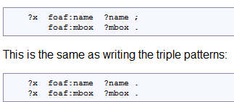
Predicate-Object Lists

Slide 6
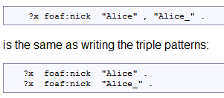
Object Lists

Slide 7
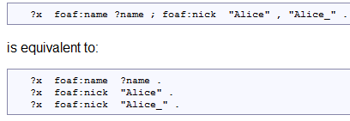
Predicate-Object Lists & Object Lists

Slide 8
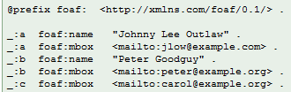

Multiple Matches

Slide 9

Multiple Matches

Slide 10
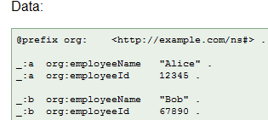
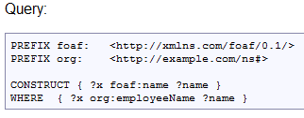
Building RDF Graphs

Slide 11
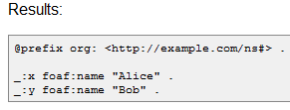
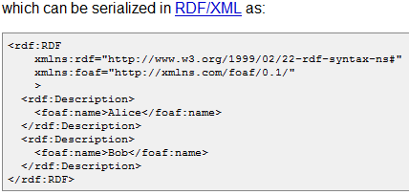
Building RDF Graphs

Slide 12
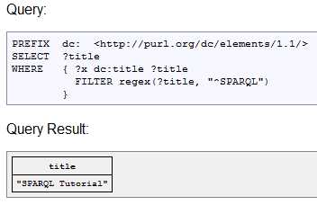
Restricting the Values of Strings

Slide 13
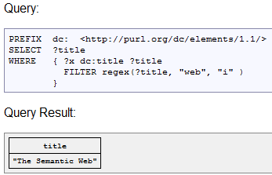
Restricting the Values of Strings

Slide 14
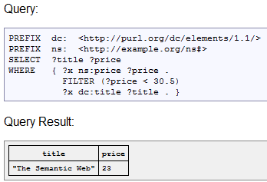
Restricting Numeric Values

Slide 15
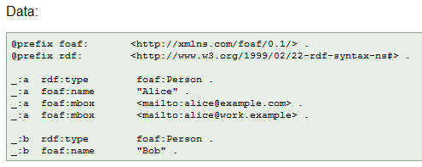
Optional

Slide 16
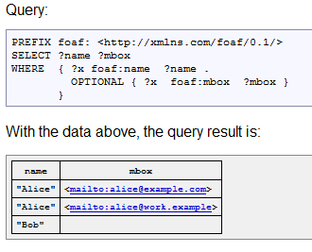
Optional

Slide 17
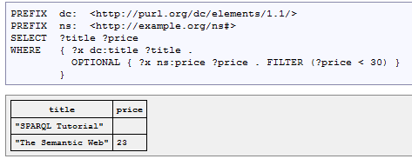
Optional & Filter

Slide 18
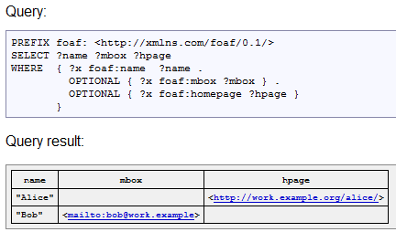
Multiple Optional

Slide 19
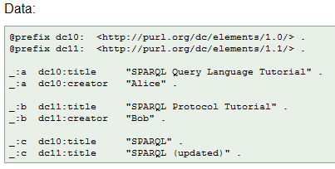
Union

Slide 20
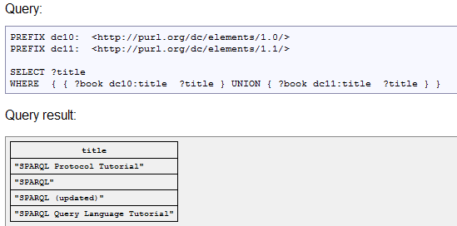
Union
?book ?P ?title
Filter(?P = dc10:title || ?P = dc11:title )

Slide 21
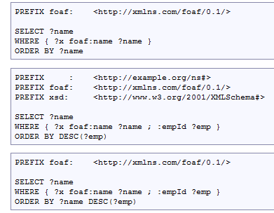
Order By

Slide 22
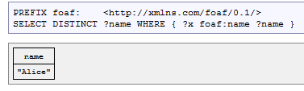
Distinct

Slide 23
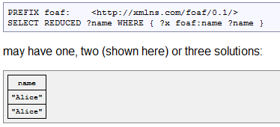
Reduced

Slide 24
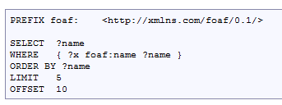
Limit & Offset

Slide 25
SELECT RETURNS ALL, OR A SUBSET OF, THE VARIABLES BOUND IN A QUERY PATTERN MATCH.
CONSTRUCT RETURNS AN RDF GRAPH CONSTRUCTED BY SUBSTITUTING VARIABLES IN A SET OF TRIPLE TEMPLATES.
ASK RETURNS A BOOLEAN INDICATING WHETHER A QUERY PATTERN MATCHES OR NOT.
DESCRIBE RETURNS AN RDF GRAPH THAT DESCRIBES THE RESOURCES FOUND.
Querry Form

Slide 26
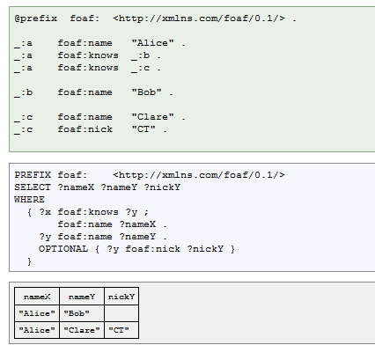
Select

Slide 27
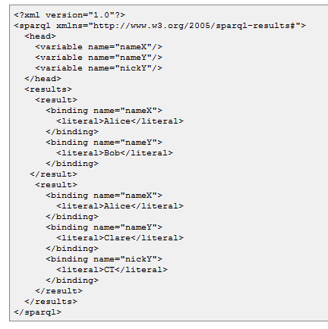

Slide 28
Operators Definitions
bound: Returns true if var is bound to a value. Returns false otherwise.
isIRI: Returns true if term is an IRI. Returns false otherwise <>
isLiteral: Returns true if term is a literal. Returns false otherwise
str: Returns the lexical form of ltrl (a literal); returns the codepoint representation of rsrc (an IRI). This is useful for examining parts of an IRI, for instance, the host-name.

Slide 29
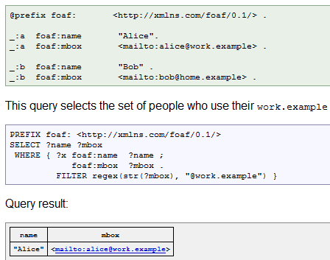

Slide 30
Operators Definitions
isBlank
lang
datatype
logical-or
logical-and
RDFterm-equal
sameTerm
langMatches
regex

Slide 31
HTTP://WWW.W3.ORG/TR/RDF-SPARQL-QUERY/
REFERENCE

